Slide 1
Causal Inference Crash Course Part 4: Best Practices: Outliers, Class Imbalance, Feature Selection, and Bad Control
Julian Hsu (@hsujulia)

Slide 2
Causal Inference Series
Foundations
Defining Some ATE/ATET Causal Models
ATE/ATET Inference, Asymptotic Theory, and Bootstrapping
Best Practices: Outliers, Class Imbalance, Feature Selection, and Bad Control
Heterogeneous Treatment Effect Models and Inference
Difference-in-Difference Models for Panel Data
Regression Discontinuity Models
Arguable Validation

Slide 3
Overview
This presentation will outline best practices for issues around causal inference which can be applied to other ML settings.
Outliers;
Class Imbalance in Propensity Scores;
Feature Selection; and
Bad Control
For each issue, we will discuss what the problem is, why it’s a problem, and a solution outline.

Slide 4
A. Outliers

Slide 6
B. Class Imbalance in Propensity Scores

Slide 8
C. Feature Selection

Slide 10
D. Bad Control

Slide 13
Appendix

Slide 14
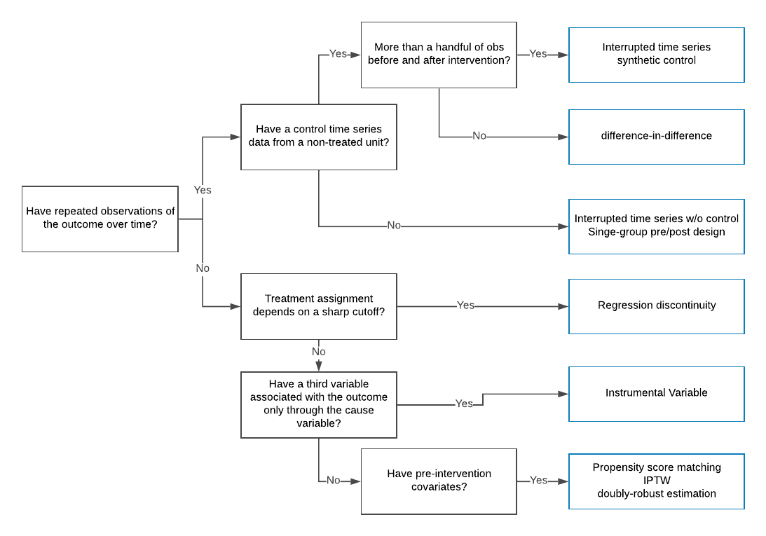
Source: https://eng.uber.com/causal-inference-at-uber/

